Slide 1
C3879C Capstone Project
Project Interim Report
PPE violations detection
Lim Zhao Hong

Slide 2
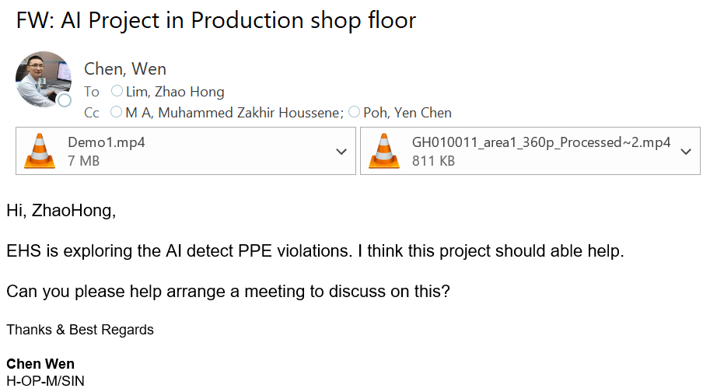
Problem Statement
Due to internal request, there is a change in project scope

Slide 3
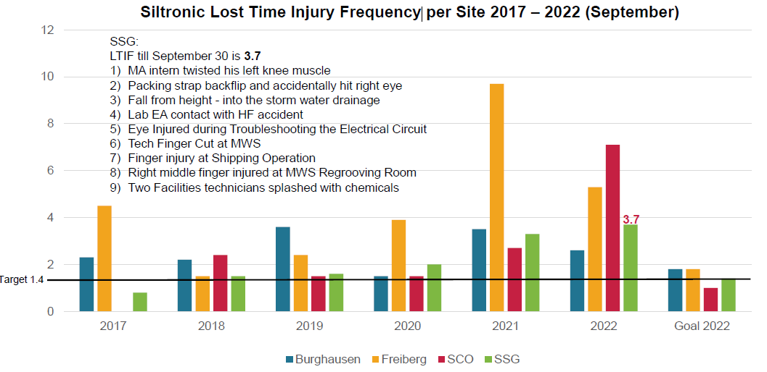
Problem Statement
Recent LTIF (Lost Time Injury Frequency) trends and accident have been escalating, which has to be improved.
site A
site B
site C
site D

Slide 4
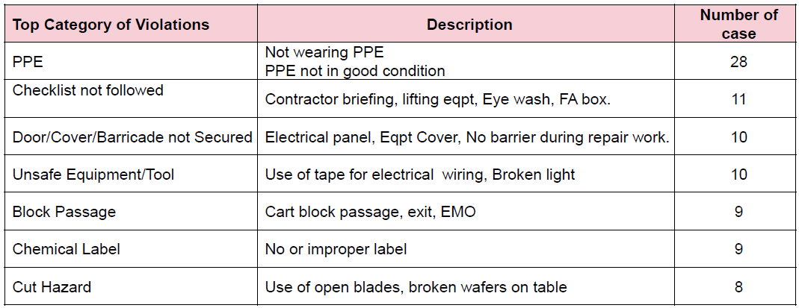
Problem Statement
Therefore it is important to avoid and prevent repetition of these or similar accidents in future.
Among the top reason that result in accident is due to Inadequate PPE protection or failing to wear PPE.

Slide 5
Project Specification
The Objective of this project to harness computer vision to detect PPE violations to raise awareness and avoid/prevent repetition of these or similar accidents in future
For a start, the project would take a series of images with people wearing and not wearing safety helmets (PPE) for training and validation purpose.
Transfer learning of the pre-trained model would be applied onto CCTV monitoring where safety helmet is required in those area

Slide 6
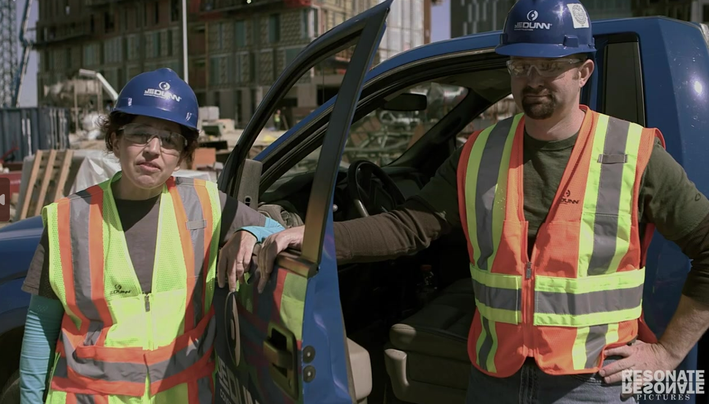
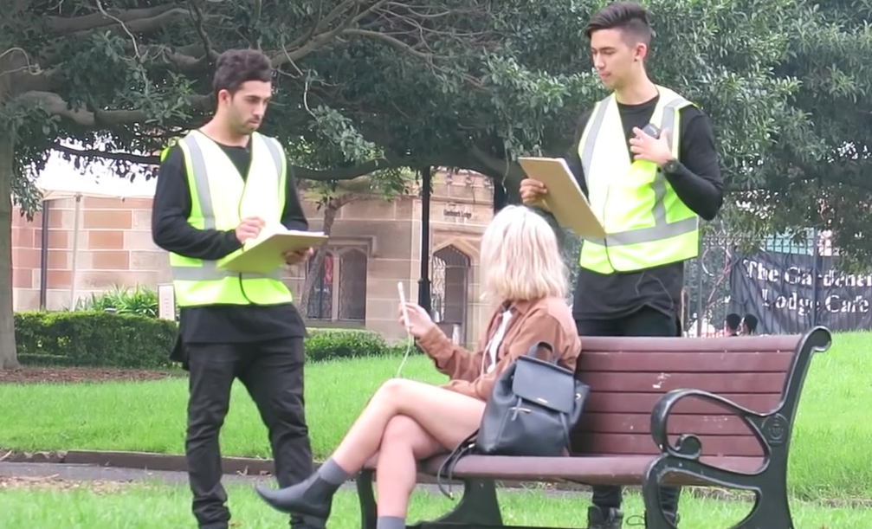
Project Methodology / Approach
Knowledge of Python, Deep learning concepts, and Computer Vision is required to process data and get an optimized pre-trained network
With the pre-trained network, it would be further deployed in actual scenario
Head
Helmet
Head
Helmet
Head

Slide 7
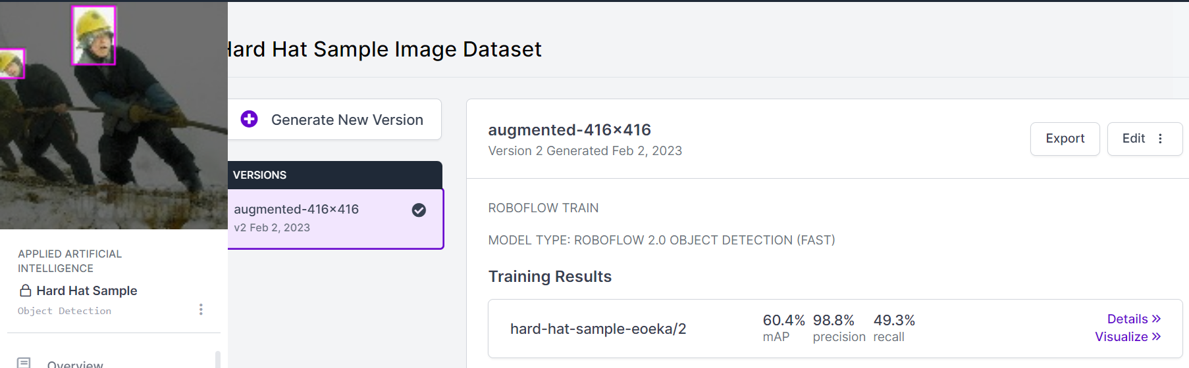
Solution Design
A series of stock photos would be selected to ensure that pre-trained model work in different environment.
Using image classification and segmentation in Roboflow, the model would detect if safety helmet is wore
If there is detection that safety helmet is not wore, a notification would be triggered to the respective department to confirm and investigate

Slide 8
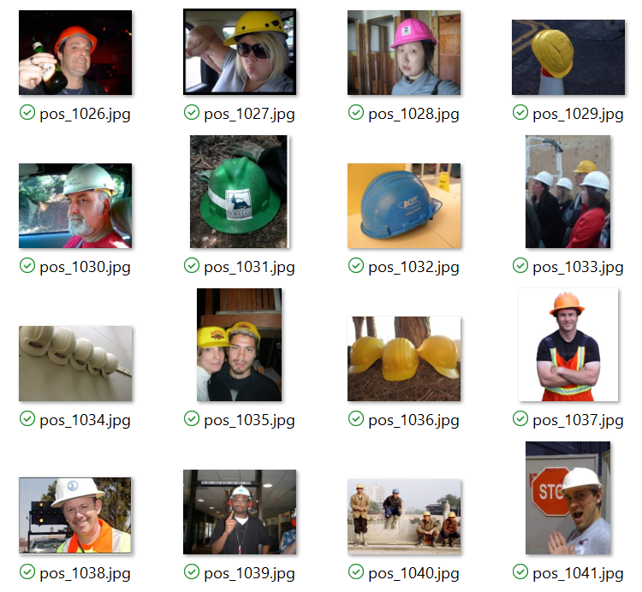
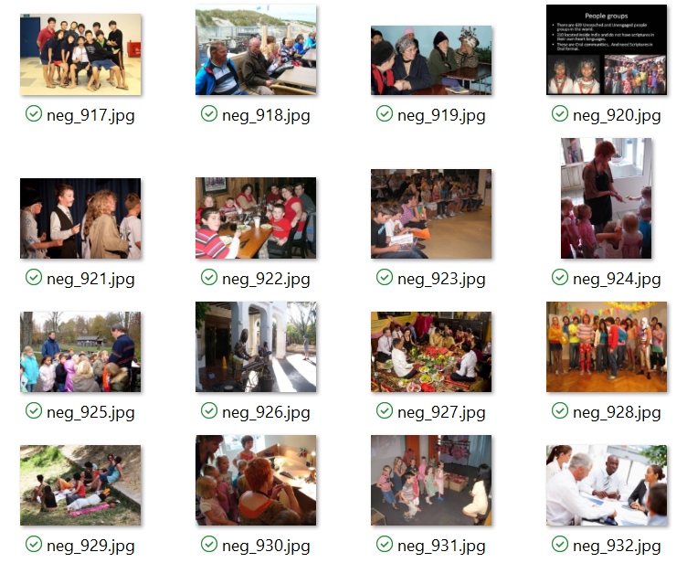
Data
Data would be collected via photos of cassettes with / without safety helmet for training
With safety helmet
Without safety helmet

Slide 9
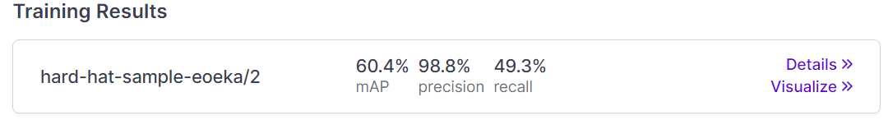
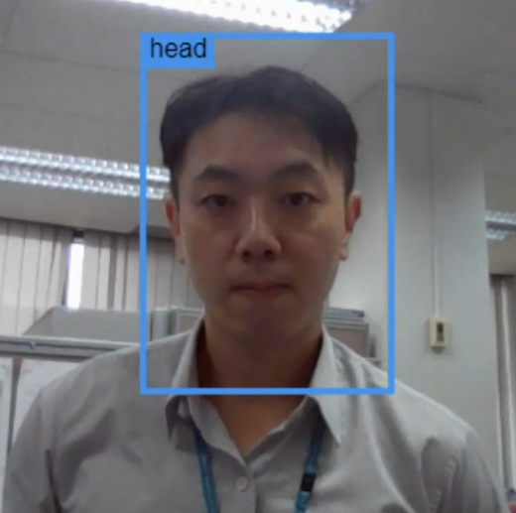
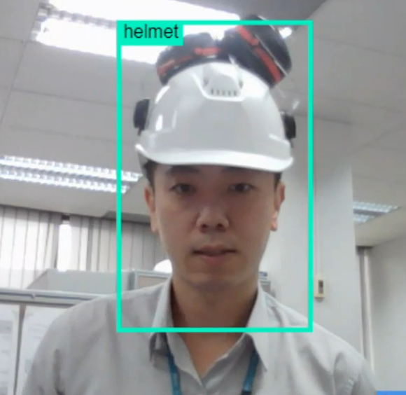
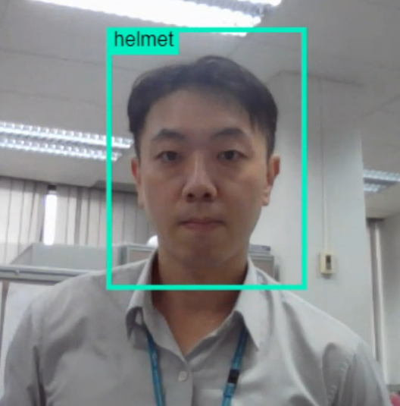
Results (interim)
Roboflow is used to train for safety helmet detection. However, the accuracy is still lacking in actual scenario
Correct Detection
Correct Detection
Incorrect Detection

Slide 10
Challenges
Besides Roboflow, are there other recommended image classification and segmentation that can be used?
Is it okay to apply available pre-trained model directly to project?
Transfer learning of pre-trained model: Any example ? How to apply onto CCTV monitoring?
How to detect non-conformance and trigger alert (e.g. email) to respective department

Slide 11
Project Schedule
Activities | 1st Mar | 5th Mar | 8th Mar | 22nd Mar | 22nd Mar | 28th Apr | 6th May
Collection of image
Python programming of model
Finetuning of Pre-train model
Submission of Interim Report
Transfer learning of Pre-train model into deployment
Submission of Reports & Project Deliverables
Oral Presentation

